Slide 1

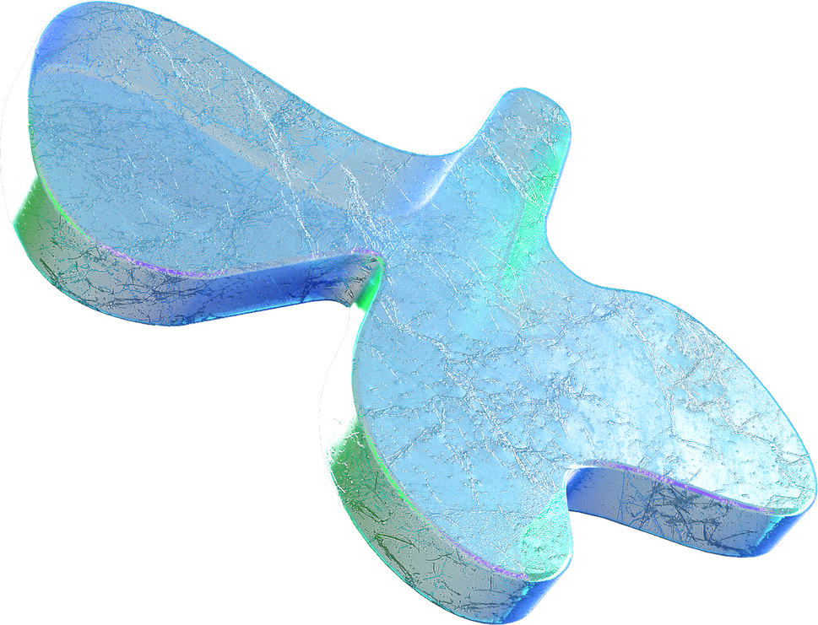
CMP 655 Wireless Networks
A digital twin based industrial automation and control system security architecture
Refik Can Öztaş

Slide 2

A digital twin based
INTRODUCTION
DIGITAL TWIN CONCEPT, RELATED WORK AND DEFINITIONS
ADVERSARY MODEL AND SECURITY REQUIREMENTS
A DIGITAL TWIN BASED SECURITY ARCHITECTURE AND STATE REPLICATION DESIGN
industrial automation and control system security architecture
SECURITY ANALYSIS
PROOF OF CONCEPT AND PERFORMANCE EVALUATION
CONCLUSION AND FUTURE WORK

Slide 3


INTRODUCTION
While security for IACS in the past was neglected, in recent years security has obtained a lot of attention in the research community and indeed within the industry. Major security incidents such as the STUXNET worm in 2010 , the Shamoon Saudi Aramao spear-phishing attack in 2012 and the German steel factory attack in 2014 have highlighted the risk of attacks on IACS. Even if the attacks have been of many different types and origins, they have highlighted the need for enhanced security mechanisms and countermeasures

Slide 4
The main contributions of the paper are the following:
•Introduce a digital twin IACS adversary model and identify security requirements for this model.
• Suggest a novel digital twin based security architecture including a new state replication model.
• Evaluate the security of the proposed state replication model as well as present a proof of concept implementation for a PLC software upgrade case including performance figures.

Slide 5
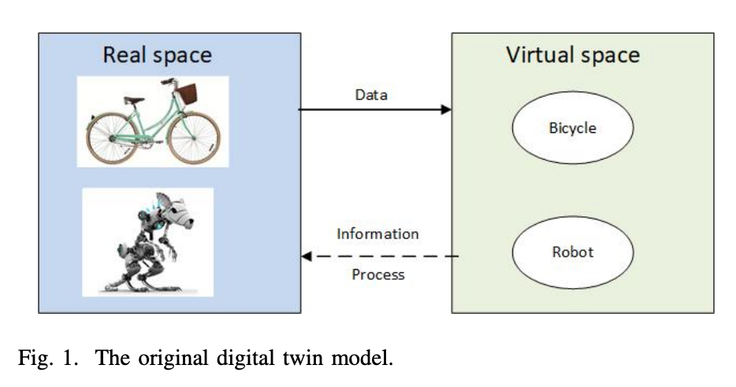

Slide 6
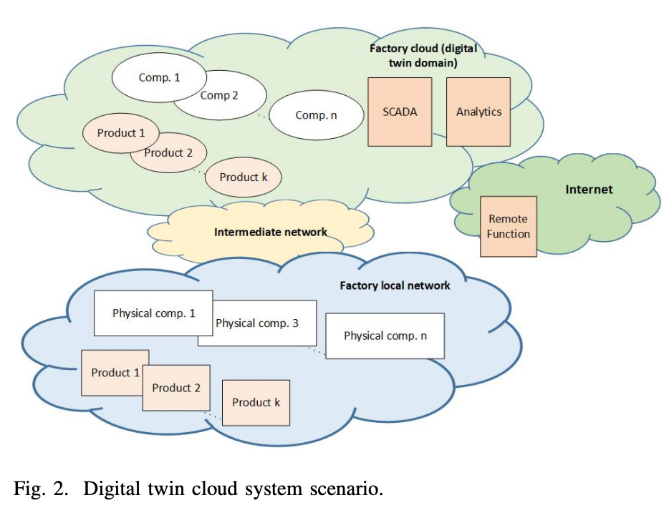

Slide 7
ADVERSARY MODEL
The attacker is able to intercept, modify and replay all communication from the physical domain to the digital domain and vice versa.
The attacker is able to launch input attacks by sending arbitrary messages to a digital twin and input requests, i.e. he or she can choose to send arbitrary input from the set Iu’ to the digital twin u’ .
The attacker is able to launch intercept, modify and replay any information sent between digital twins or between digital twins and other units executing in the virtual domain.

Slide 8
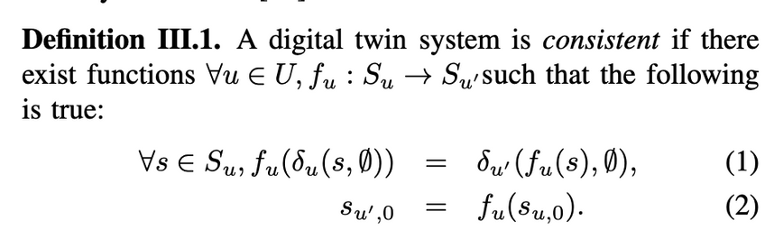
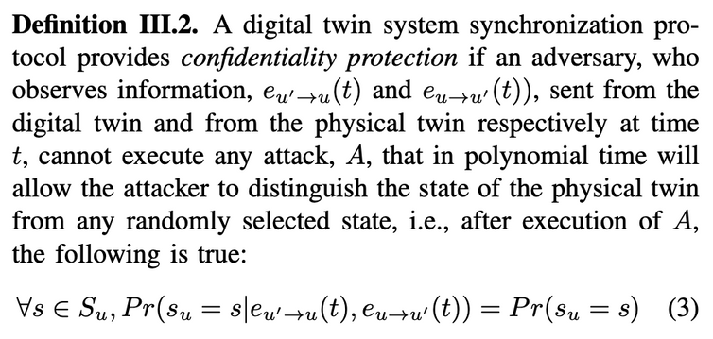
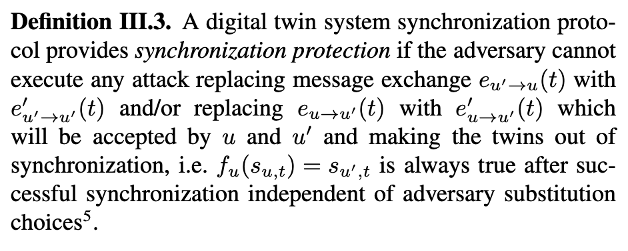
Security definitions
The basis of the new security architecture is the introduction of state replication between the physical and digital twin.
This definition reflects the requirement that when the digital twin starts in a state consistent with the staring state of the physical counterpart and whenever neither the physical twin nor the digital twin receive any input, they are both always transitioned to states that are consistent. i.e. the physical to digital twin state mapping agree with the state of the digital twin.

Slide 9
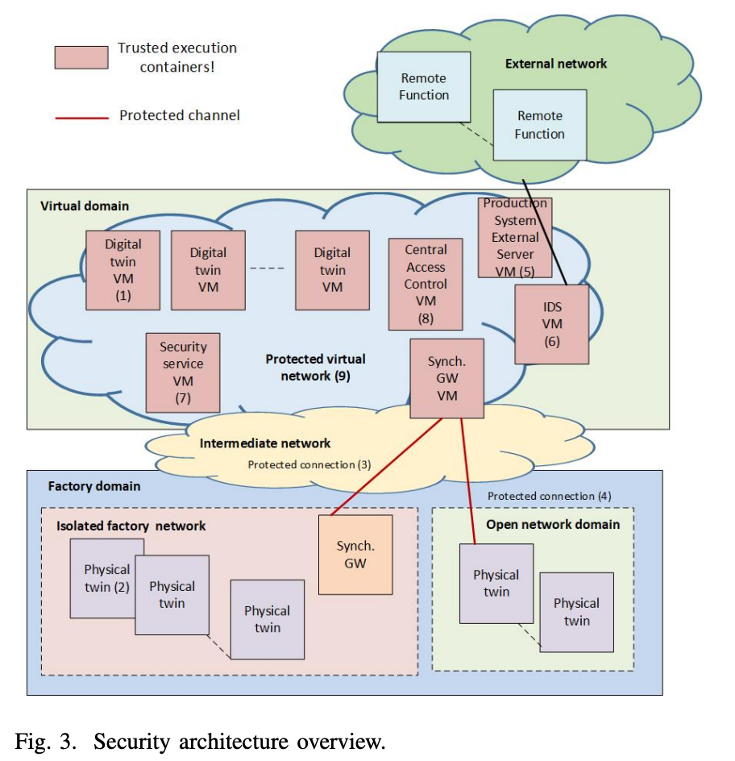

Slide 10
Requirements
R1
R2
R3
R4
R5
Synchronization security
Synchronization latency
Digital twin external connections protection
Access control
Software security
R6
R7
Local factory network isolation
Digital twin Denial-of-Service (DoS) resilience

Slide 11
Security architecture
A basic security assumption in this architecture is the possibility to launch digital twins as well as security services in trusted execution containers as Virtual Machines (VMs) on suitable cloud resources. The architecture is completely agnostic on the virutalization technique used for this or on which actual level the vitalization is applied

Slide 12
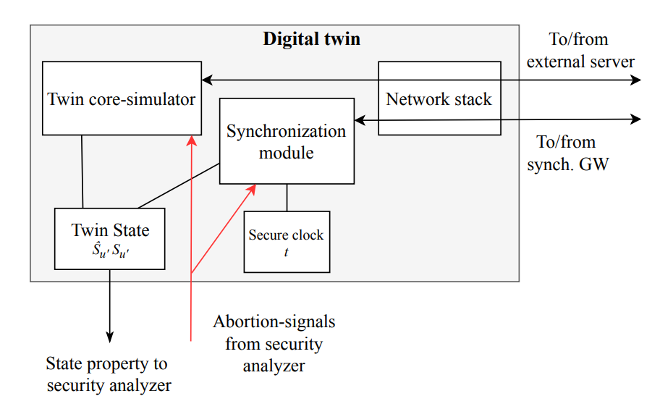
Digital twin component
The digital twin operates as a virtual machine (VM) in an isolated environment, with core functionality focused on simulating its physical counterpart. External network interactions are limited to synchronization and exchanges with external requests and responses. These interactions occur through the cloud server or directly with other digital twins or back-end components. The virtual domain connections are secured through a cloud Virtual Private Network (VPN). The digital twin's state is exported to a security analysis component, allowing external analyzers access to all states in the system for security checks. The system includes a secure clock for precise synchronization with the physical twin, and the state propagation design is detailed in Section IV-B.

Slide 13
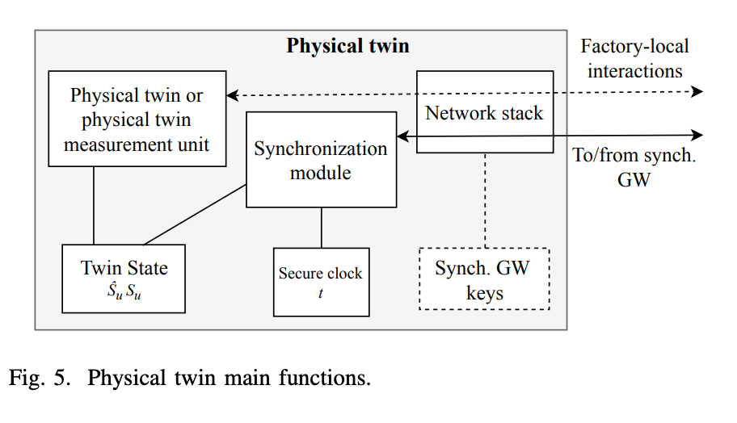
Physical twin component
The physical twin, depicted in Fig. 5, operates with logic similar to its digital counterpart. It executes the defined synchronization protocol, and the synchronization can be performed directly by the physical twin or through a "measurement unit" if network connectivity is absent. In an isolated factory network, synchronization occurs with a dedicated synchronization GW on the same network. For a physical twin deployed outside this network, synchronization information is directly exchanged with the synchronization GW in the virtual domain, requiring access to key material for secure interactions. Besides synchronization considerations, the physical twin does not require additional security adaptations. The state propagation design for the physical twin is detailed in Section IV-B.

Slide 14
Protected connection between synchronization gateways
The connection between the local factory's synchronization GW and the virtual domain is safeguarded through a secure channel, opting for this approach over end-to-end synchronization protection. This choice is based on the assumption that synchronization GWs can be deployed in trusted containers within the virtual domain. Standard security measures like IPsec VPN or TLS/DTL channels are considered. This approach offers the advantage of maintaining a single security relationship between the physical and digital domains, simplifying security management. It contrasts with a scenario where external entities connect directly to the physical domain, requiring separate security relationships for each external connection. By centralizing these relations in the digital domain, security risks are reduced, and configuration management becomes less complex.

Slide 15
Protected connection from isolated physical twin to synchronization gateway
A physical twin not deployed in a protected local factory network, needs to directly connect to the synchronization GW in the virtual domain. This connection then obviously needs to be confidentiality and integrity protected using a suitable secure channel

Slide 16
Production system external server
The architecture assumes all external requests arrives in the virtual domain, i.e. external input to digital twin u 0 from the set Iu’ arrives to the production system external server prior to (potential) being forwarded to the digital twin u’ . Similar responses from a digital twin are routed through this sever as well. This allows advanced network filtering at a single point and avoids having such functionality duplicated at each digital twin virtual instance

Slide 17
Intrusion Detection System (IDS)
State-of-the art IDS are best deployed at the boarder to the internet. We adopt this principle and assume the actual intrusion analysis to be done by a VM with direct access to the external network interface traffic.

Slide 18
Security analysis service
The core benefit from a security perspective with a digital twin model like the one we have defined, is the possibility to do security analysis directly on the digital twin state and even on the states of a whole family of digital twins. By letting the analyzing engine having access not only to the final states, but also intermediate states, i.e. the sˆu’ states in the system, it is possible for a security analysis function to detect harmful state transitions (prior to the state propagating to the physical twin) and take direct action in the digital domain

Slide 19
By letting all external digital twin access be subject to a single point access control, system wide policies can easily be deployed in the system. Advanced security policies can be defined through standard access control frameworks such as Extensible Access Control Markup Language (XACML) . In order to allow direct interaction between digital twins, this is preferably combined with component local policy enforcement through tokens issued at the central access control entity using standard tokens such as SAML or OAuth .
Central access control

Slide 20
Protected virtual network
Most cloud providers offer network isolation between VMs launched on cloud resources. Even if we have not assumed all trusted execution services to be deployed as complete, ”traditional” VMs in the virtual domain, higher layer VMs can be launched on such VMs allowing re-use of standard principles for network isolation. There are also other, non-provider dependent solutions to achieve this

Slide 21
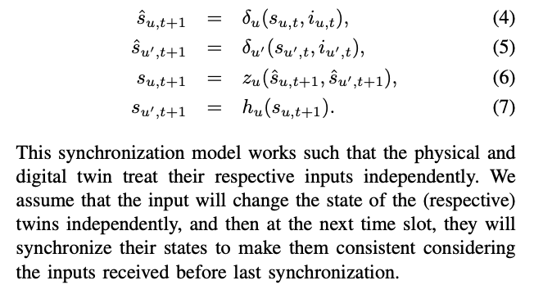
State replication model and design

Slide 22
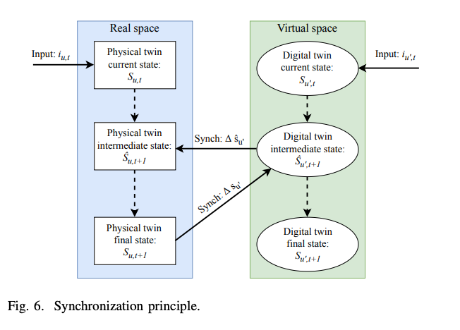
State replication model and design

Slide 23





Security Analysis

Slide 24
Synchronization security

Slide 25
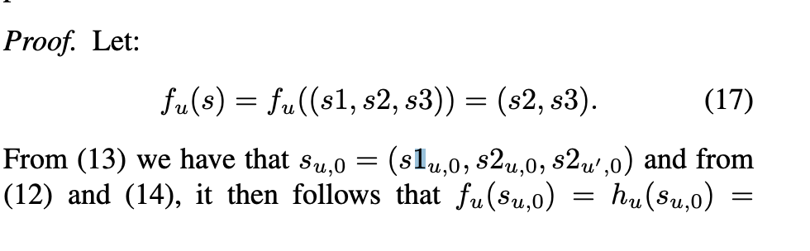
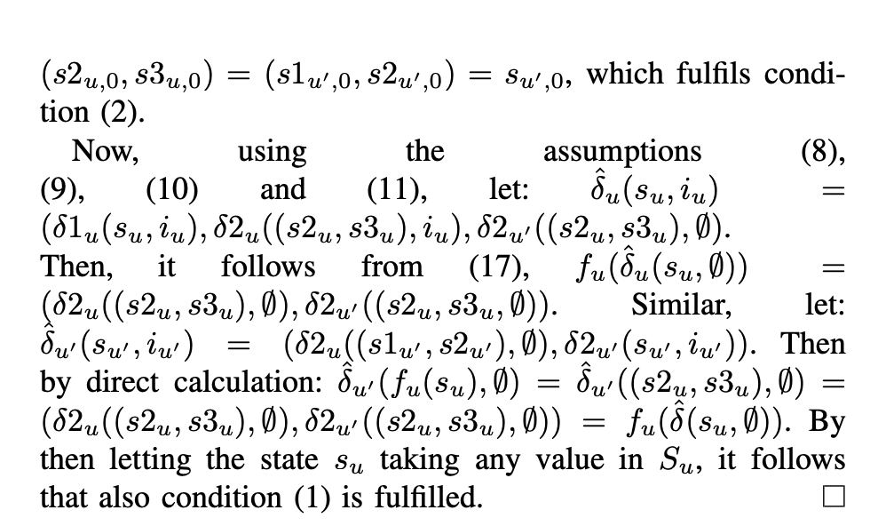
Proposition 1
The digital twin synchronization model and protocol is consistent.

Slide 26
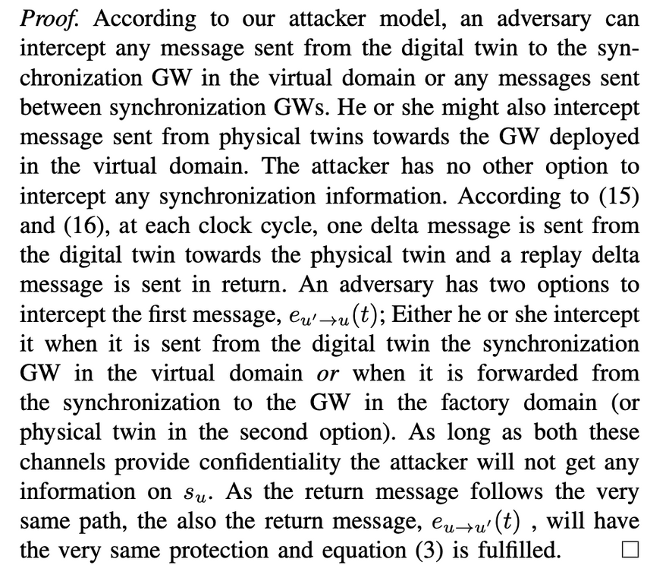
Proposition 2
If the secure channel used for communication towards and between synchronization GW in the architecture provides confidentiality, the digital twin synchronization design also provides confidentiality.

Slide 27
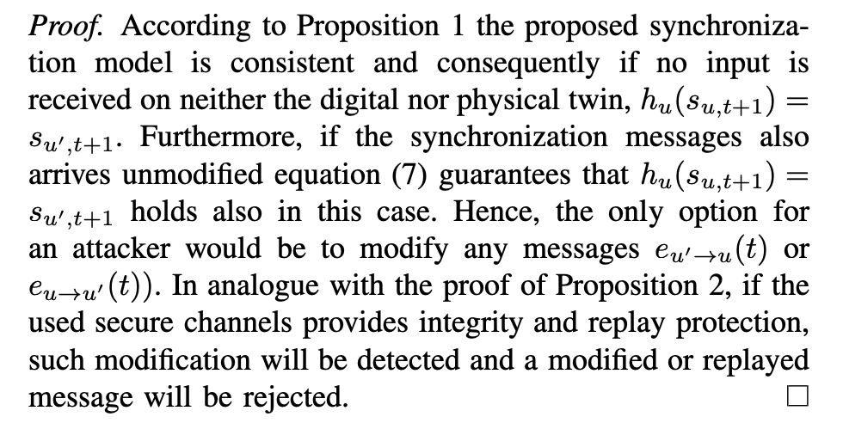
Proposition 3
If the secure channel used for communication towards and between synchronization GW in the architecture provides integrity and replay protection, the digital twin synchronization design also provides synchronization protection.

Slide 28
Latency: The architecture as such does not make any direct assumption regarding the synchronization real-time behaviour. Depending on the specific IACS application, the networks must be chosen and configured accordingly. Similarly, the synchronization GW must be implemented on platforms powerful enough to fulfill real-time requirements. For some applications, deploying the virtual domain on an edge cloud can be used to meet R2.
External connections: The architecture assumes all external connection to be intermediates by the external server entity at the boarder of the external network. The external server will only accept authenticated requests. Furthermore, the final hop for the external server to the digital twin runs through the virtual domain VPN. This, if properly implemented, implies that the system fulfills the requirement R3
Access control: According to the proposed security architecture, the centralized access control VM deployed in the virtual domain makes sure all access requests towards the digital twin are properly authorized. Access control enforcement then takes place at the digital twin VM. This means that the main building blocks are included to fulfil R4. However, the actually authorization and access control mechanisms which are supported are subject to detailed design, which have been left for future work.

Slide 29
Software security: The software state of the physical twin can be replicated to the digital counterpart. A security service with direct access to the twin state can be launched. This service then controls the physical twin software state and upgrade. This is a very efficient way to both monitor the SW status and control upgrades as we show with the experimental evaluation in Section Section VI. Even if this is an important step to meet R5, further SW monitoring tools needs to be deployed in the system to give the wanted software security level.
Network isolation and DoS resilience: The architecture adopts best practise for factory network isolation to meet R6. In addition, external interaction with the factory domain is only possible indirectly through the protected synchronization. All direct requests towards digital twin are subject to IDS and filtering and additional security protection mechanism can be launched as security service VMs in the virtual domain. With proper design and implementation, such measures will provide network isolation and DoS resilience as required by R7.

Slide 30
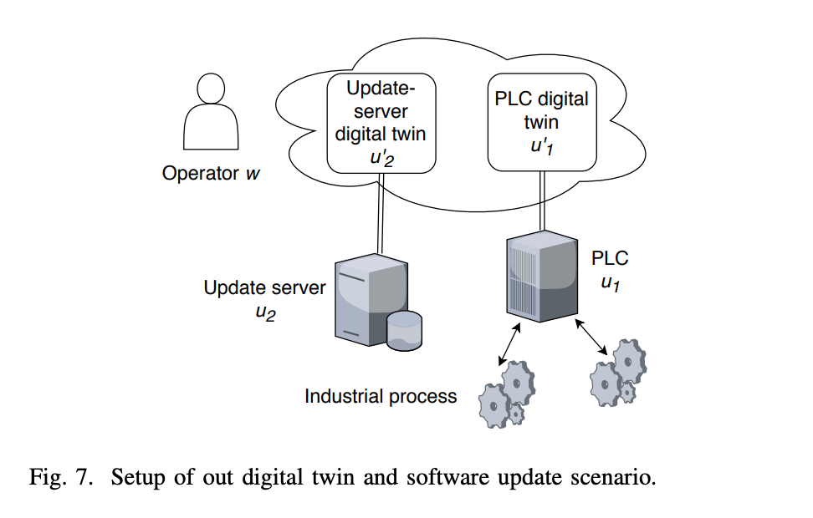
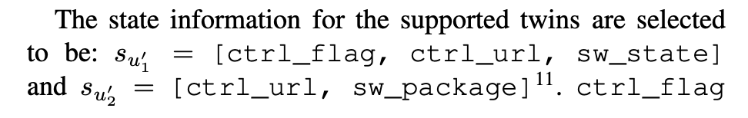
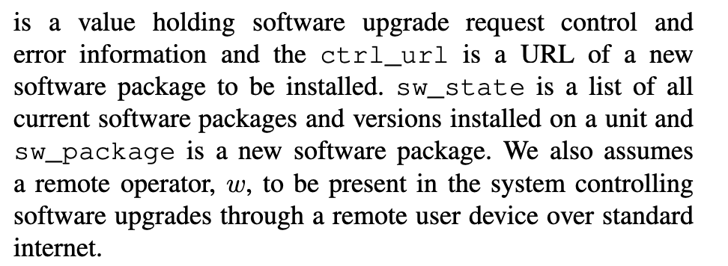
PROOF OF CONCEPT AND PERFORMANCE EVALUATION

Slide 31
PLC software update process: In this scenario, a software package "q" is identified by the unit "w," which connects to an external server "u₀₂" and downloads the package to u₀₂. After receiving a ctrl_url value, u₀₂ updates its state, and synchronization occurs between u₀₂ and "u₂." The synchronization involves sending ∆sˆu₀₂ = ctrl_url + q from u₀₂ to u₂, triggering u₂ to update its internal state by storing "q." Unit "w" then makes a second request to u₀₁ using the received ctrl_url, providing information about the new software package. This prompts u₀₁ to update its states, and the information is propagated to u₁, resulting in an updated state su₁,₂. The software update flag in su₁,₂ triggers u₁ to set the state to update pending, allowing u₂ to download and install the new software package "q" using ctrl_url. Once the update is completed, the status information and new software state are propagated back to u‘₁.
Performance evaluation: The implemented scenario involves a software update process using digital twins. The PLC u1 is represented by the OpenPLC, a free and open-source implementation, running on a Raspberry Pi model 2 v1.1 with an ARM Cortex-A7 quad-core processor. The digital twins, u₀₁ and u₀₂, operate as separate processes on a host running Ubuntu 18.04, which also serves as the update server u2. The synchronization protocol between physical entities and digital twins, occurring outside the factory network, is secured using DTLS.

Slide 32
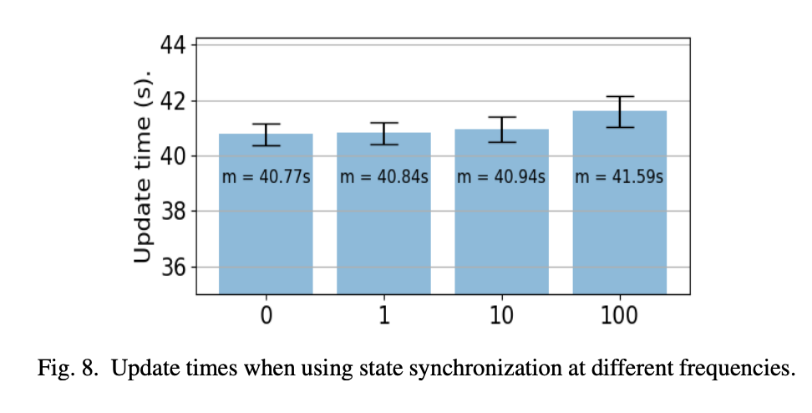
Update time depending on synchronization frequency
The evaluation of the state synchronization protocol focused on the SW update scenario, analyzing its impact on other system processes. The tests were conducted in stages: first, without state synchronization to establish a baseline update process time, and then with different frequencies of state synchronization (1, 10, and 100 per second). The results, depicted in Figure 8, indicate minimal performance impact, with noticeable effects observed only at a high frequency of synchronizations per second.

Slide 33
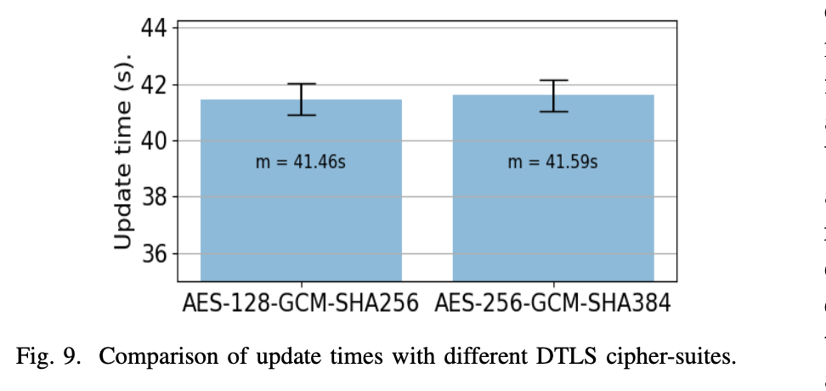
Compassion of DTLS Cipher Suites
They have compared different DLTS cipher suites to evaluate if this impacts performance. The default strong suite AES-256-GCM with SHA384 was compared to the weaker AES-128-GCM with SHA256. The results can be seen in Figure 9. It can be noted that the choice of ciphers has only a very small impact on the performance of the update process.

Slide 34
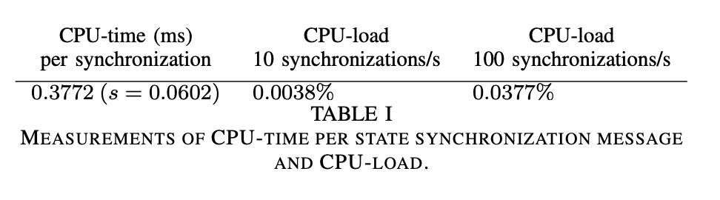
Computation cost
A PLC is not a constrained device in a traditional sense, however, since it controls a timecritical process CPU-time is limited. Any added features must consider this so time-critical deadlines are kept. We have measured the CPU-time needed by the PLC to implement our state synchronization protocol. By running the protocol over an extended time we have come to the following numbers as seen in Table I. As shown in the table the CPU-time needed by the PLC to implement the state synchronization protocol is very small. An even slower CPU will still be able to run the state synchronization without overloading the processor.

Slide 35
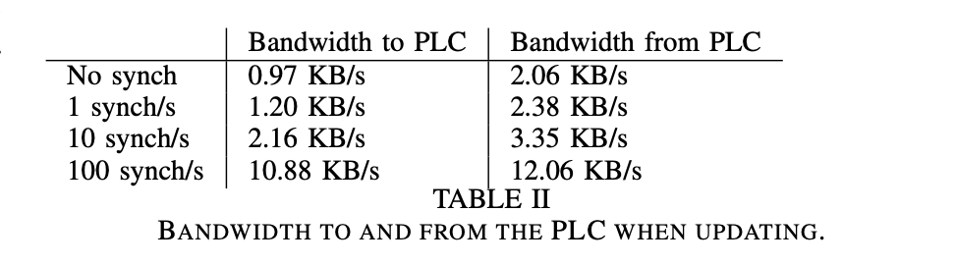
Network performance
Evaluating network performance for the state synchronization process proved challenging without real ICS network traffic as a basis. Consequently, the assessment was conducted in an isolated system, measuring the PLC's bandwidth consumption during the update process. Bandwidth consumption was also measured while synchronizing with the PLC's digital twin, using 22-byte synchronization messages in each direction. The results, summarized in Table II, indicate reasonable bandwidth consumption, particularly for small synchronization frequencies.

Slide 36

ConculusioN
In response to the demand for new security models in Industrial Automation and Control Systems (IACS) to facilitate cloud-based processing and data sharing, our investigation focused on leveraging digital twins as security enablers. We introduced a novel adversary model, established basic security definitions, identified security requirements, and proposed an innovative security architecture, particularly in the context of state replication for a digital twin-based IACS. Our synchronization design and architecture were evaluated against the identified requirements, demonstrating that the proposed synchronization design meets the introduced digital twin synchronization requirements. Through a proof of concept implementation and performance evaluation, we illustrated the effectiveness of the digital twin synchronization model in a real production case with reasonable performance impact, especially when update frequency is not excessively high. The results suggest that a digital twin-based security architecture holds promise for securing IACS while enabling external data sharing and access. Future work is needed for further development and refinement of the proposed architecture and approach.

Slide 37
FUTURE
WORK
DIRECTION
Performance
Intrusion detection
Access control
Formal security analysis
Security analysis services

Slide 38

THANK YOU

